Slide 1
Department of Mathematics

Slide 2
welcome / Açılış:
Our Academic Staff
Mathematics is art and science
I want to be a Mathematician
Mathematics is the heart of Science
The mathematics program at BAU
Bölüm Akademik Kadrosu
Sanat ve Bilimde Matematik
Bilimin kalbinde Matematik
Bir matematikçi olmak
BAU Matematik Bölüm Programı

Slide 3
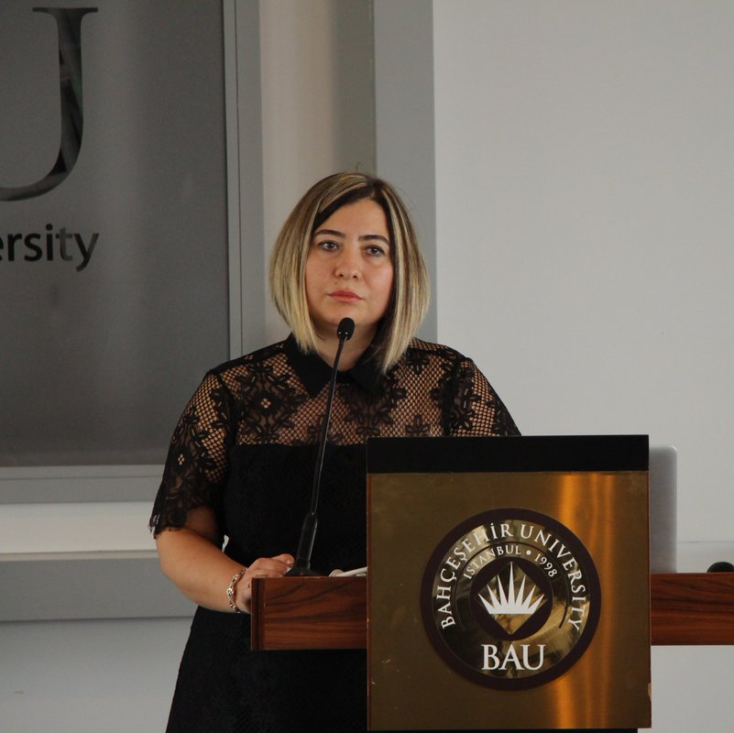
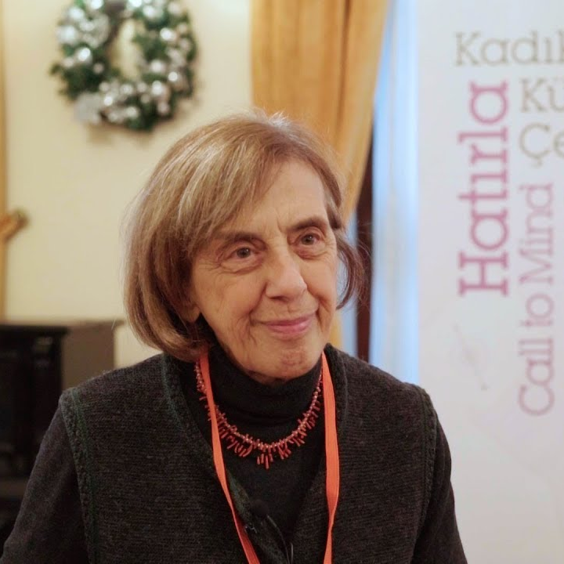
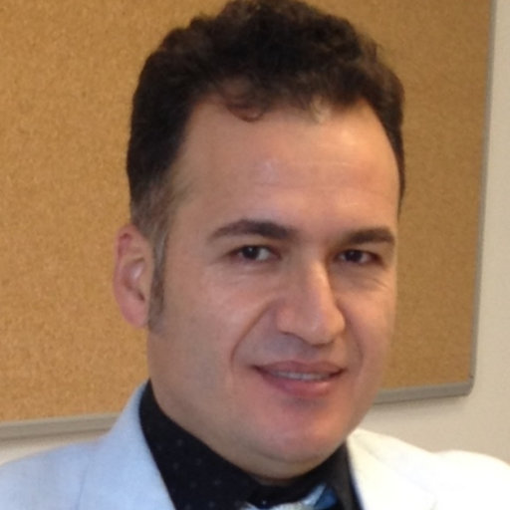
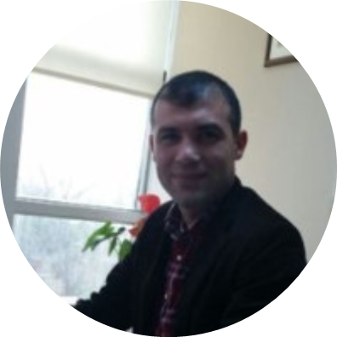
Doç. Dr. Süreyya AKYÜZ
Prof. Dr. İrini DİMİTRİYADİS
Prof. Dr. Tofigh ALLAHVIRANLOO
Doç. Dr. Maksat Ashyraliyev
(Department Head)

Slide 4
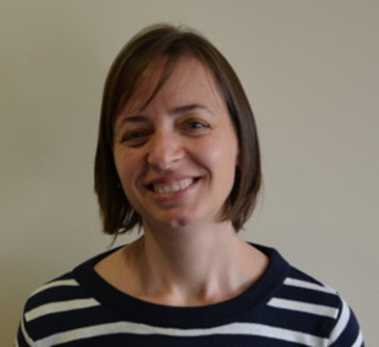
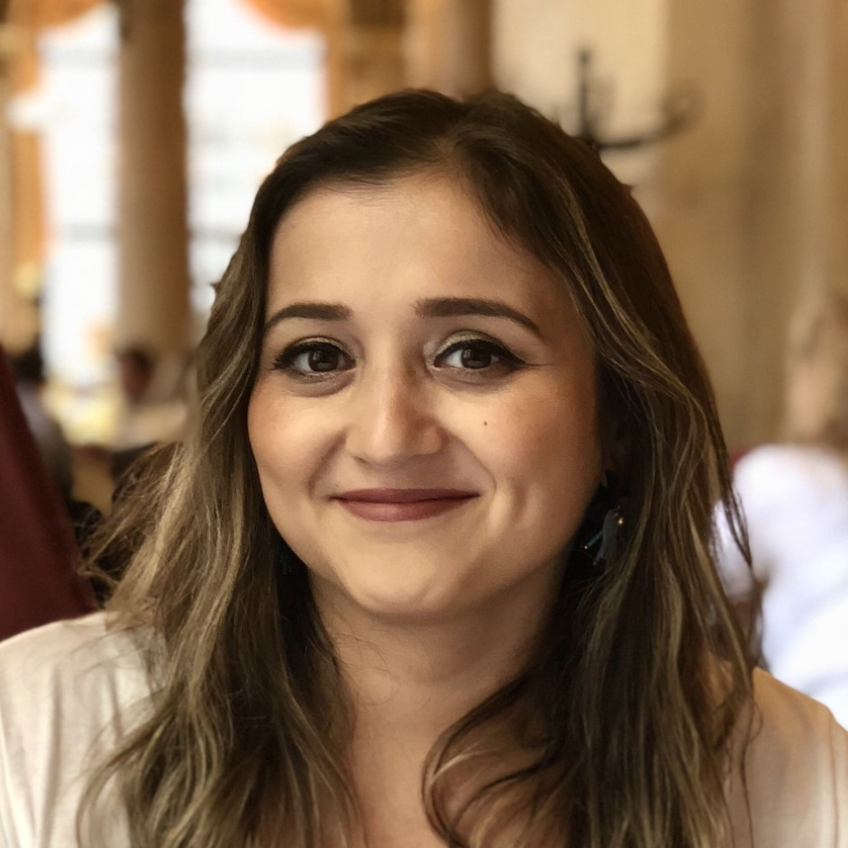
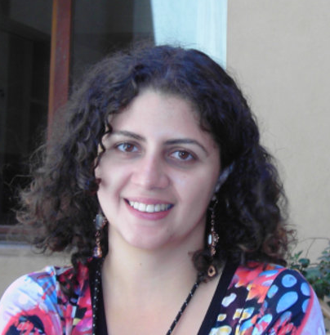
Dr. Lavdie RADA
Dr. Gülsemay YIĞIT
Dr. Nermine EL SISSI

Slide 5
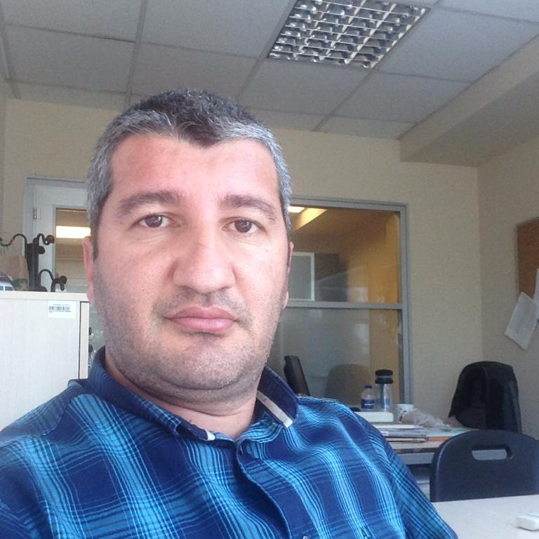
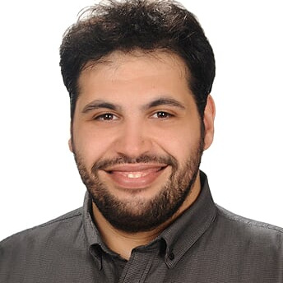
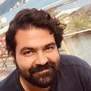
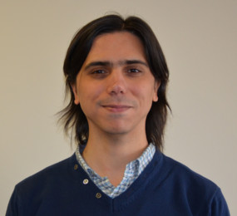
Dr. Mahmoud BELAGHI
Dr. Mohamed KHALIFA
Dr. Soheil SALAHSHOUR
Dr. Doğan AKCAN

Slide 6
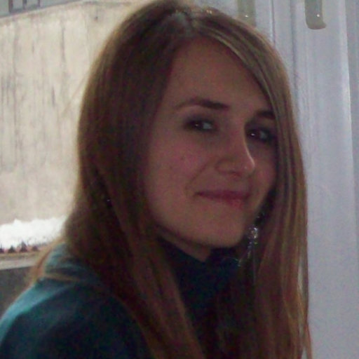
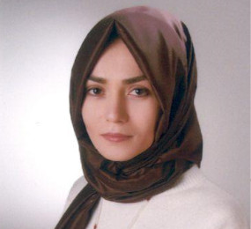
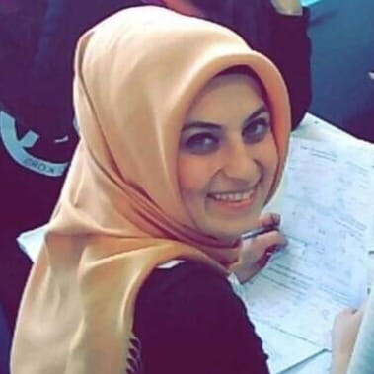
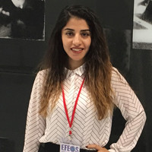
Duygu ÜÇÜNCU
Aysun SOYSAL
Kübra DEĞERLİ
Gülşah BOZCU

Slide 7
Definitions / Tanımlar
Axioms / Aksiyomlar
Theorems / Teoremler
Proofs / İspatlar
Problems / Problemler
Methods / Metotlar
What is Mathematics?

Slide 8
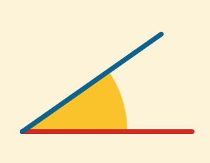
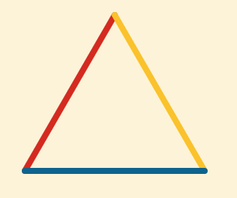
Definitions / tanımlar:
Line
Angle
Triangle
Doğru
Açi
Üçgen

Slide 9
Axioms / aksİyomlar:
❶ Magnitudes which coincide with one another are equal.
❶ Birbiriyle çakışan şeyler birbirine eşittir.
❷ There is a unique line that connects two different points.
❷ İki noktadan yalnızca bir doğru geçer.

Slide 10
Theorems / TEOREMLER:
If / Eğer:
=
&
=
&
=
Then / O halde:
=

Slide 11
Proofs / KANITLAR:
Imagine that we place the two triangles one above the other such that the vertex of one of the equal angles, or , shall fall upon that of the other and coincide with it, coincides with , and coincides with . The axiom ❶ guarantees that such placing of the triangles is indeed possible. If this placing applied, then the endpoints of and will coincide. Therefore, by axiom ❷, we must have , and the proof is established.
=

Slide 12
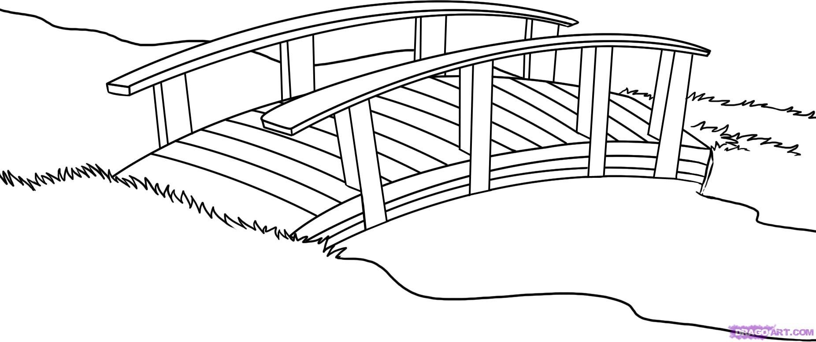
Problems / PROBLEMLER:
Mathematical Problems
Real-Life Problems
Pure Mathematics
Applied Mathematics
Matematiksel Problemler
Gerçek Hayat Problemleri
Teorik Matematik
Uygulamalı Matematik

Slide 13
Problems / PROBLEMLER:
Number Theory

Slide 14
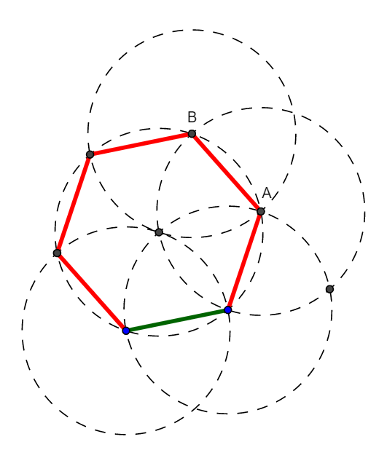
Methods / metotlar:
How to construct a regular hexagon on a given line segment?
Verilen doğru parçasını kullanarak, bir düzgün altıgen nasıl oluşturabiliriz?

Slide 15
Definitions / Tanımlar
Axioms / Aksiyomlar
Theorems / Teoremlar
Proofs / İspatlar
Problems / Problemler
Methods / Metotlar
Tools / Rigour
Araçlar / Kesinlik
Heart / Soul
Kalp/ Ruh

Slide 16
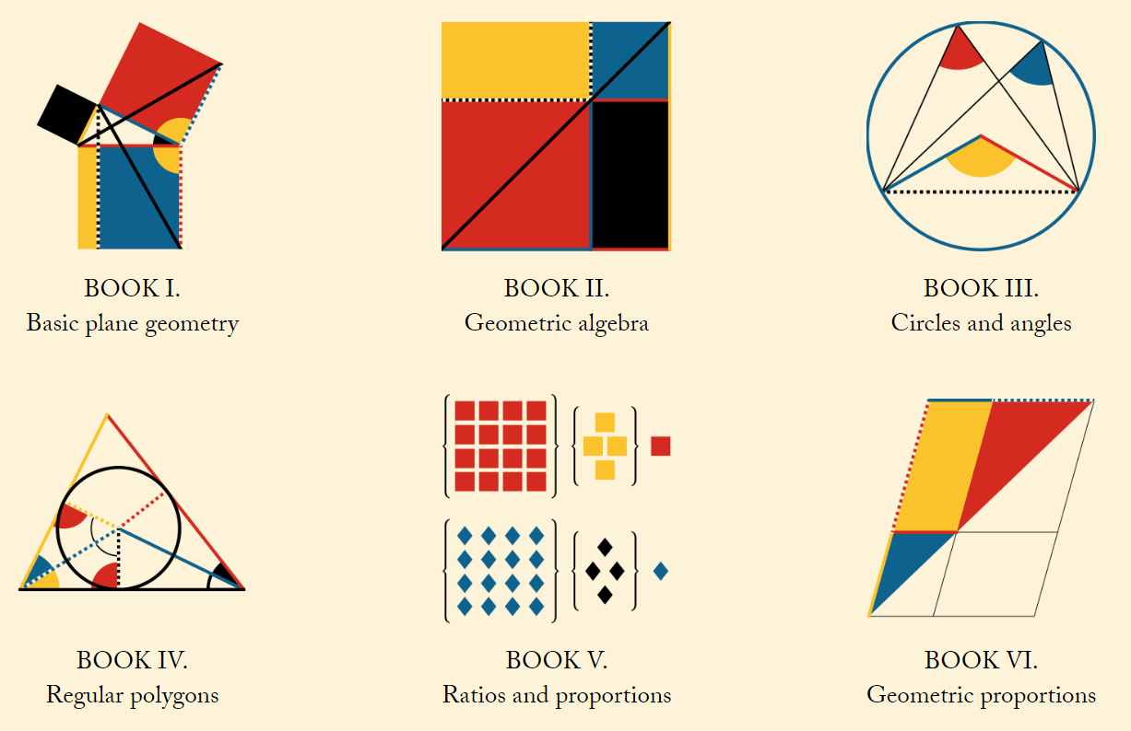
EUCLID’s Elements / ÖKlİd’İN ELEMANLARI
https://www.c82.net/euclid/

Slide 17
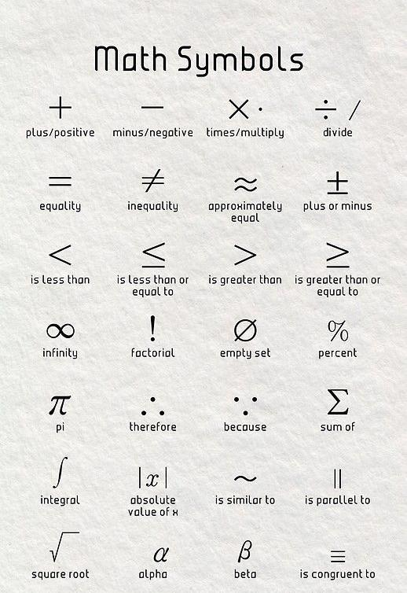
Symbolic Mathematics SEMBOLİK MATEMATİK

Slide 18
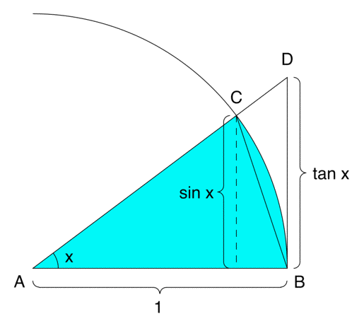
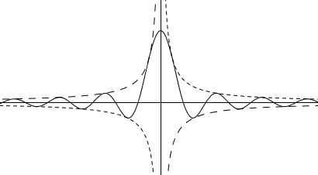
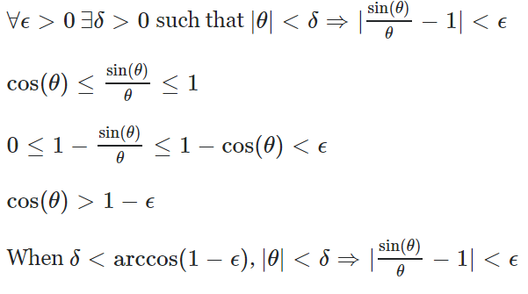

Slide 20
Satisfaction / tatmİn:

Slide 21
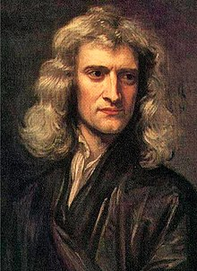
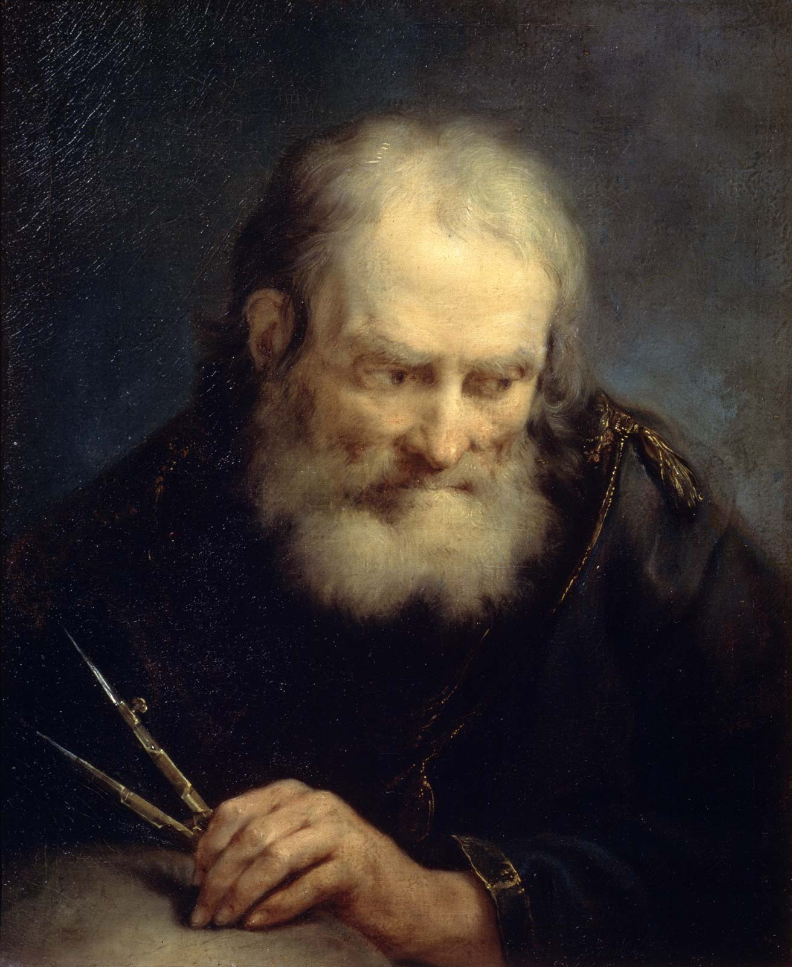
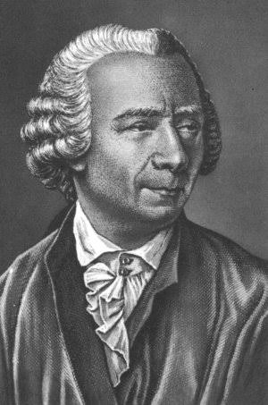
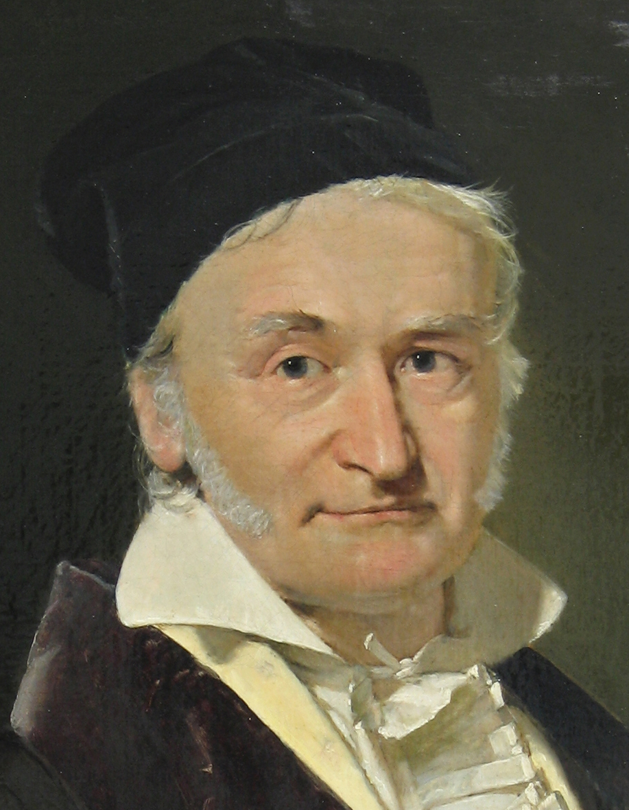
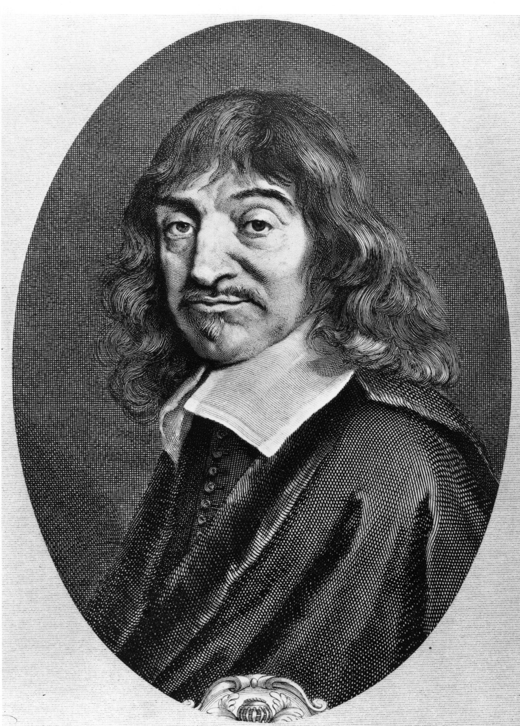
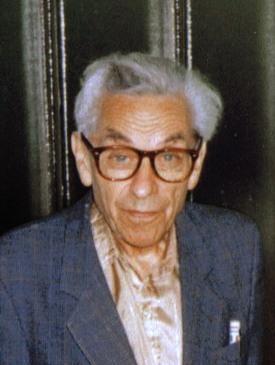
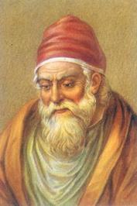
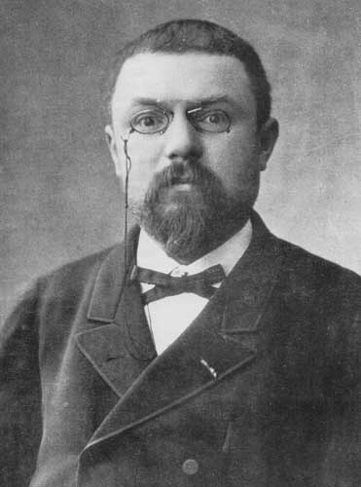
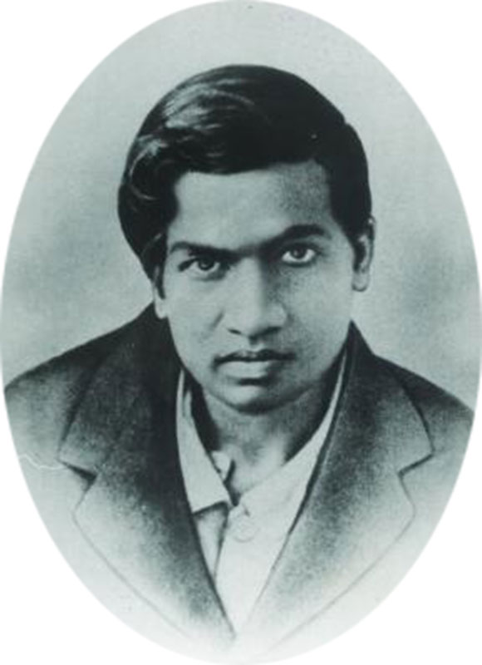
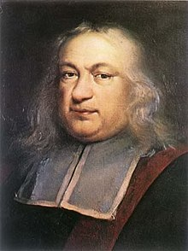
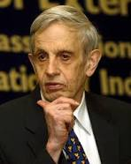
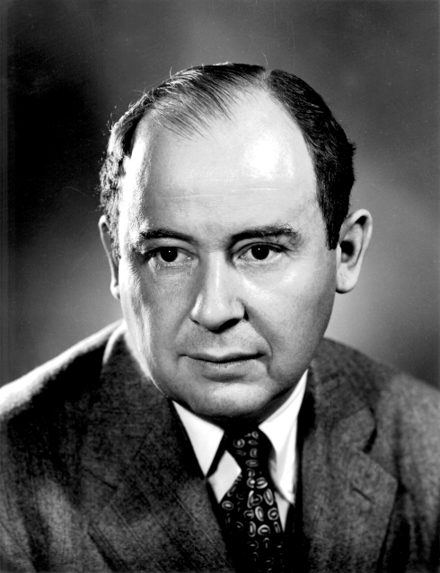
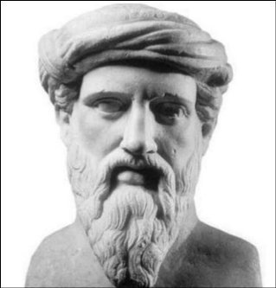
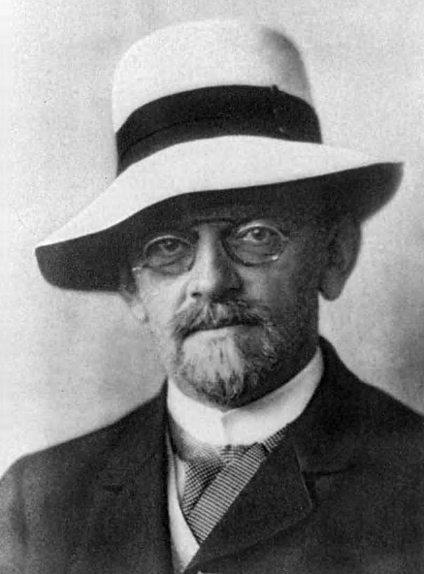
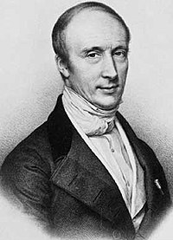
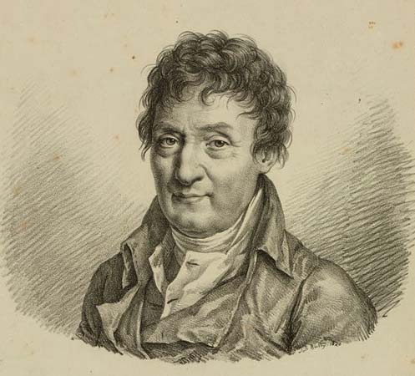
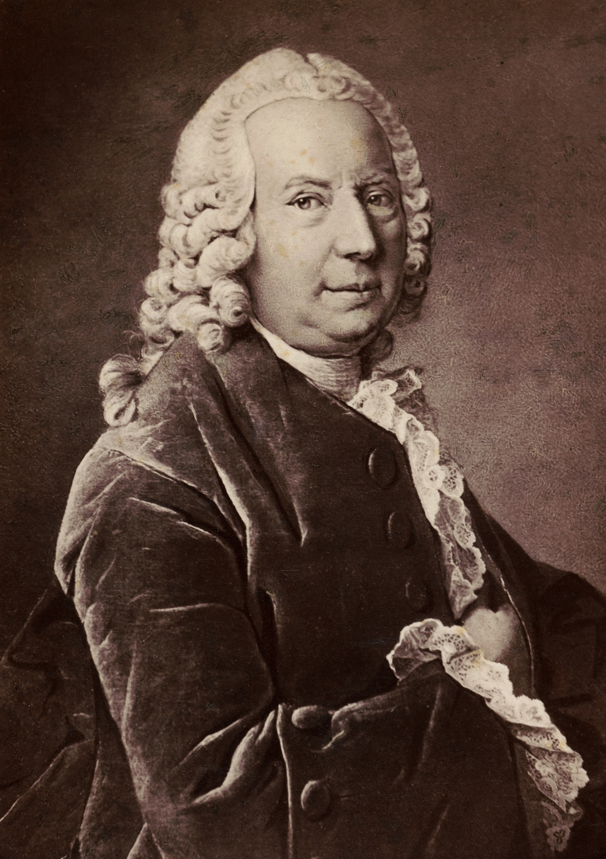
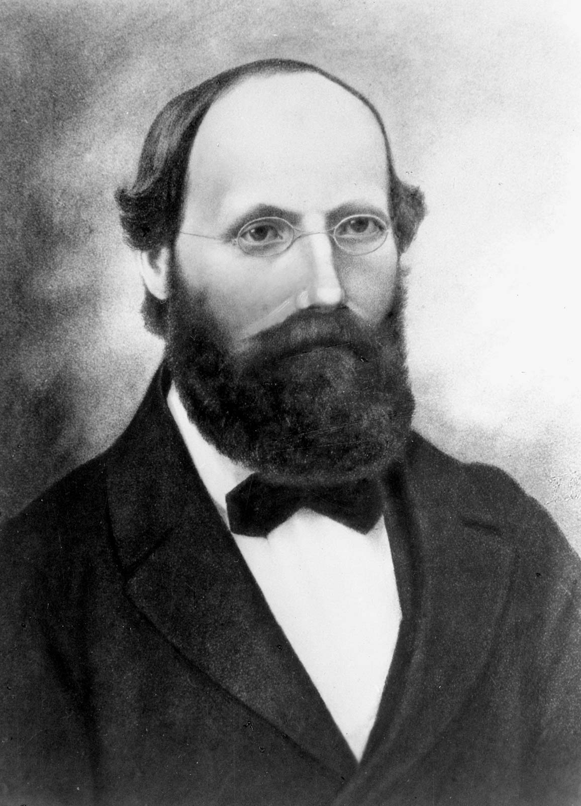
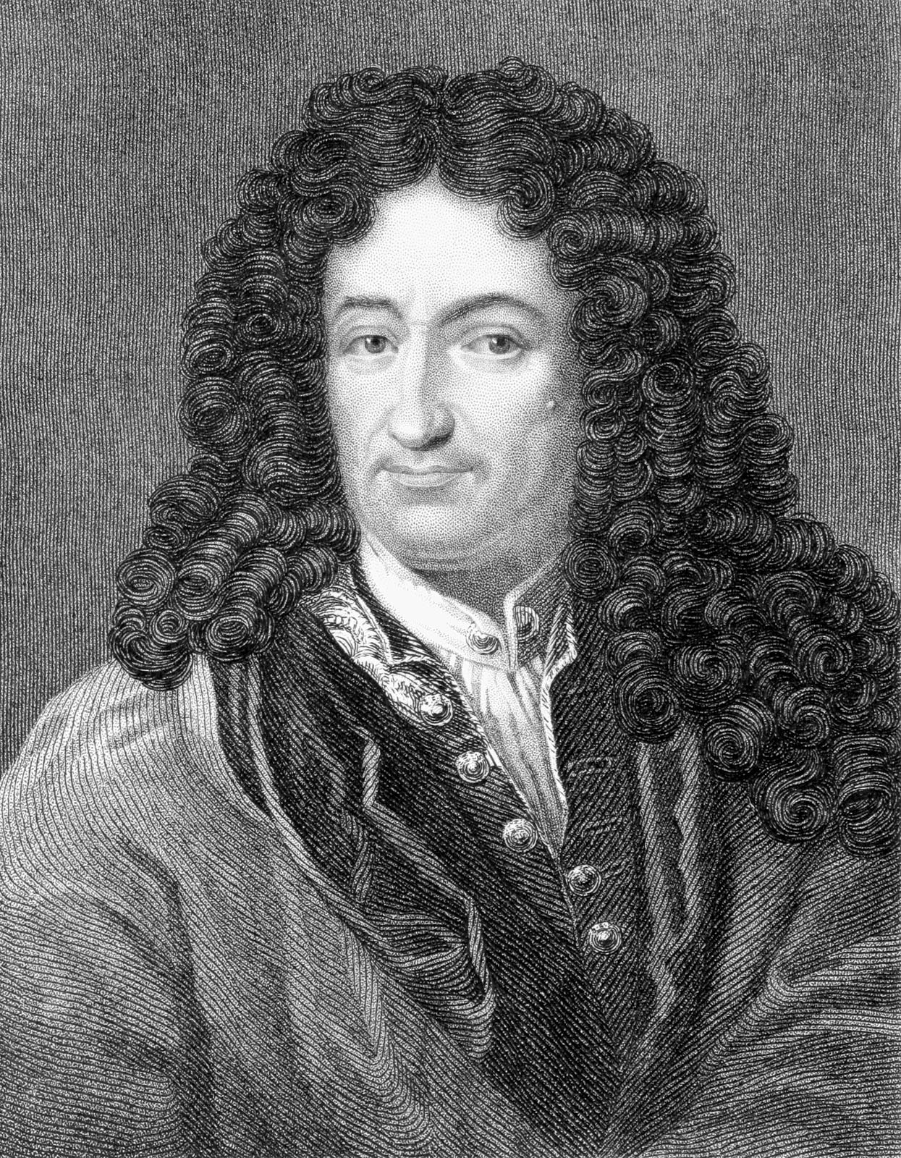
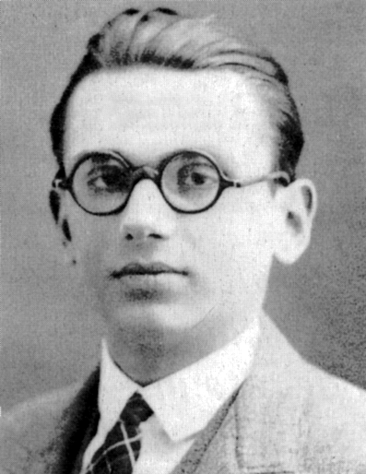
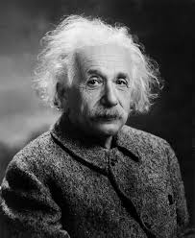
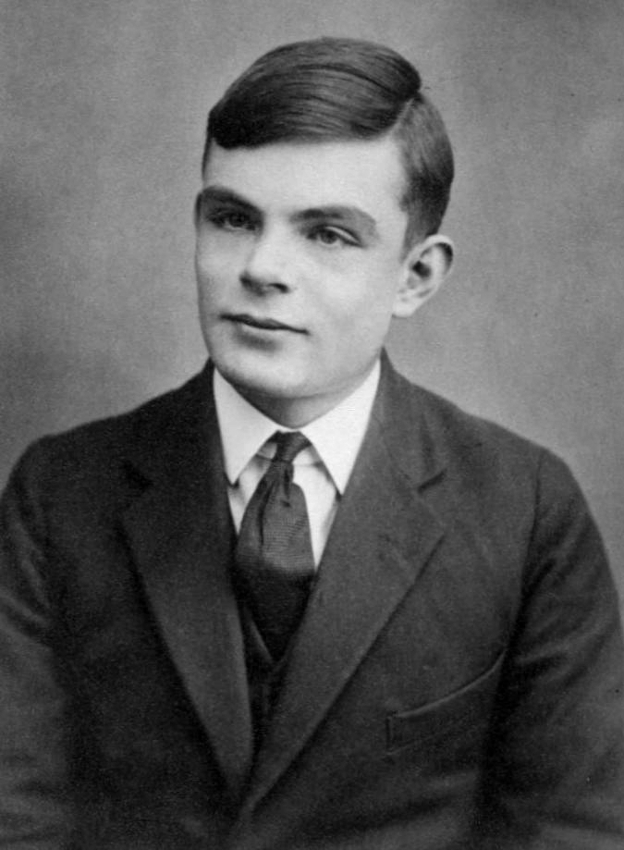
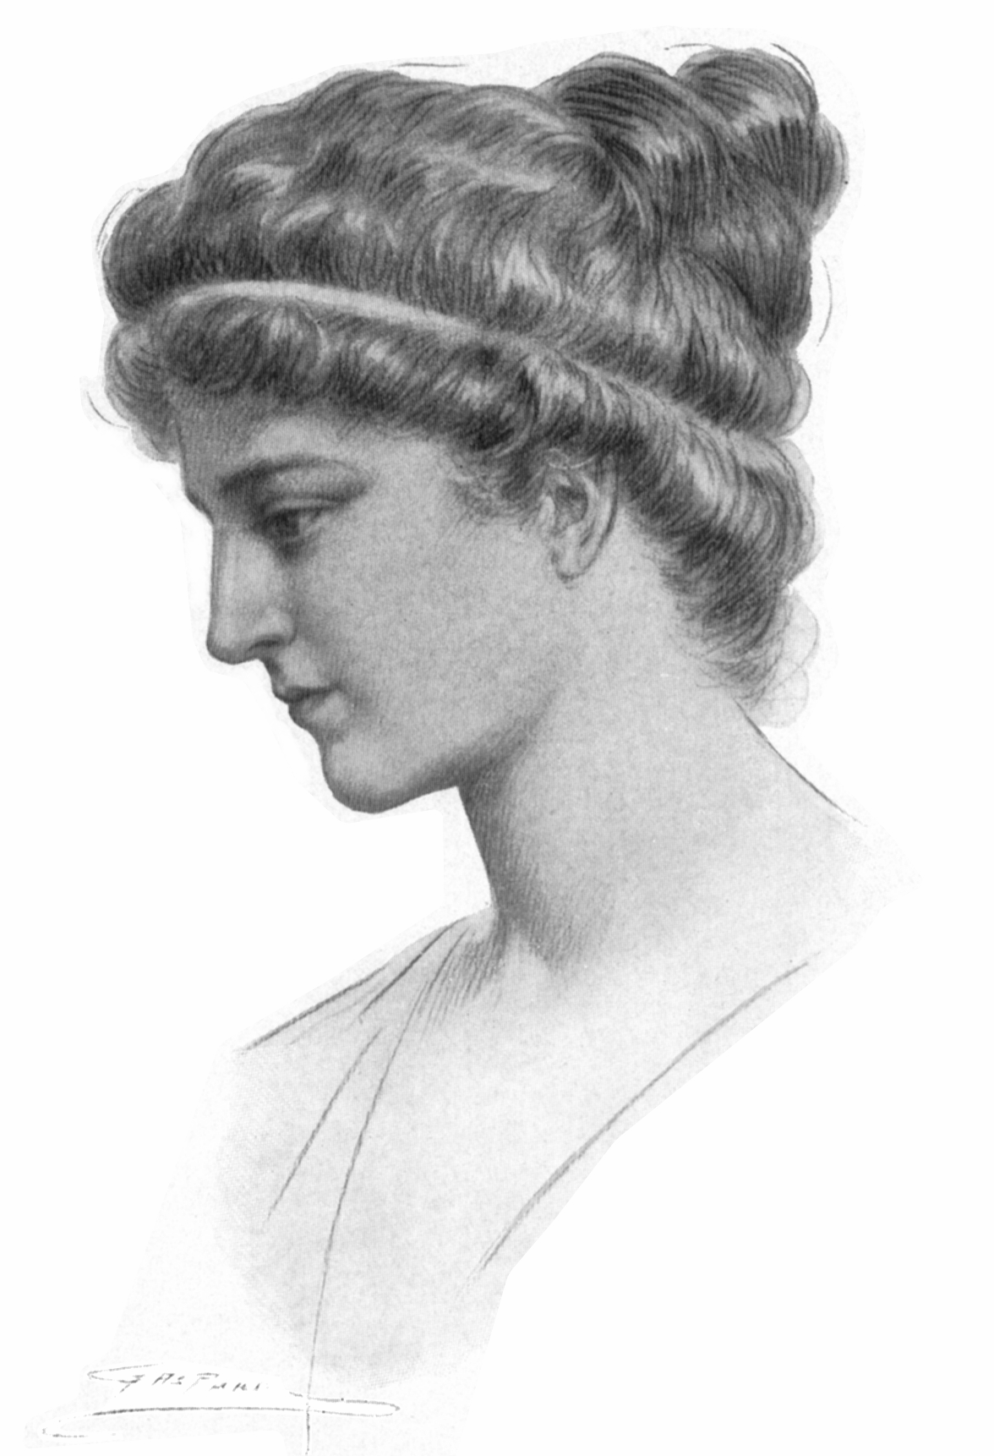
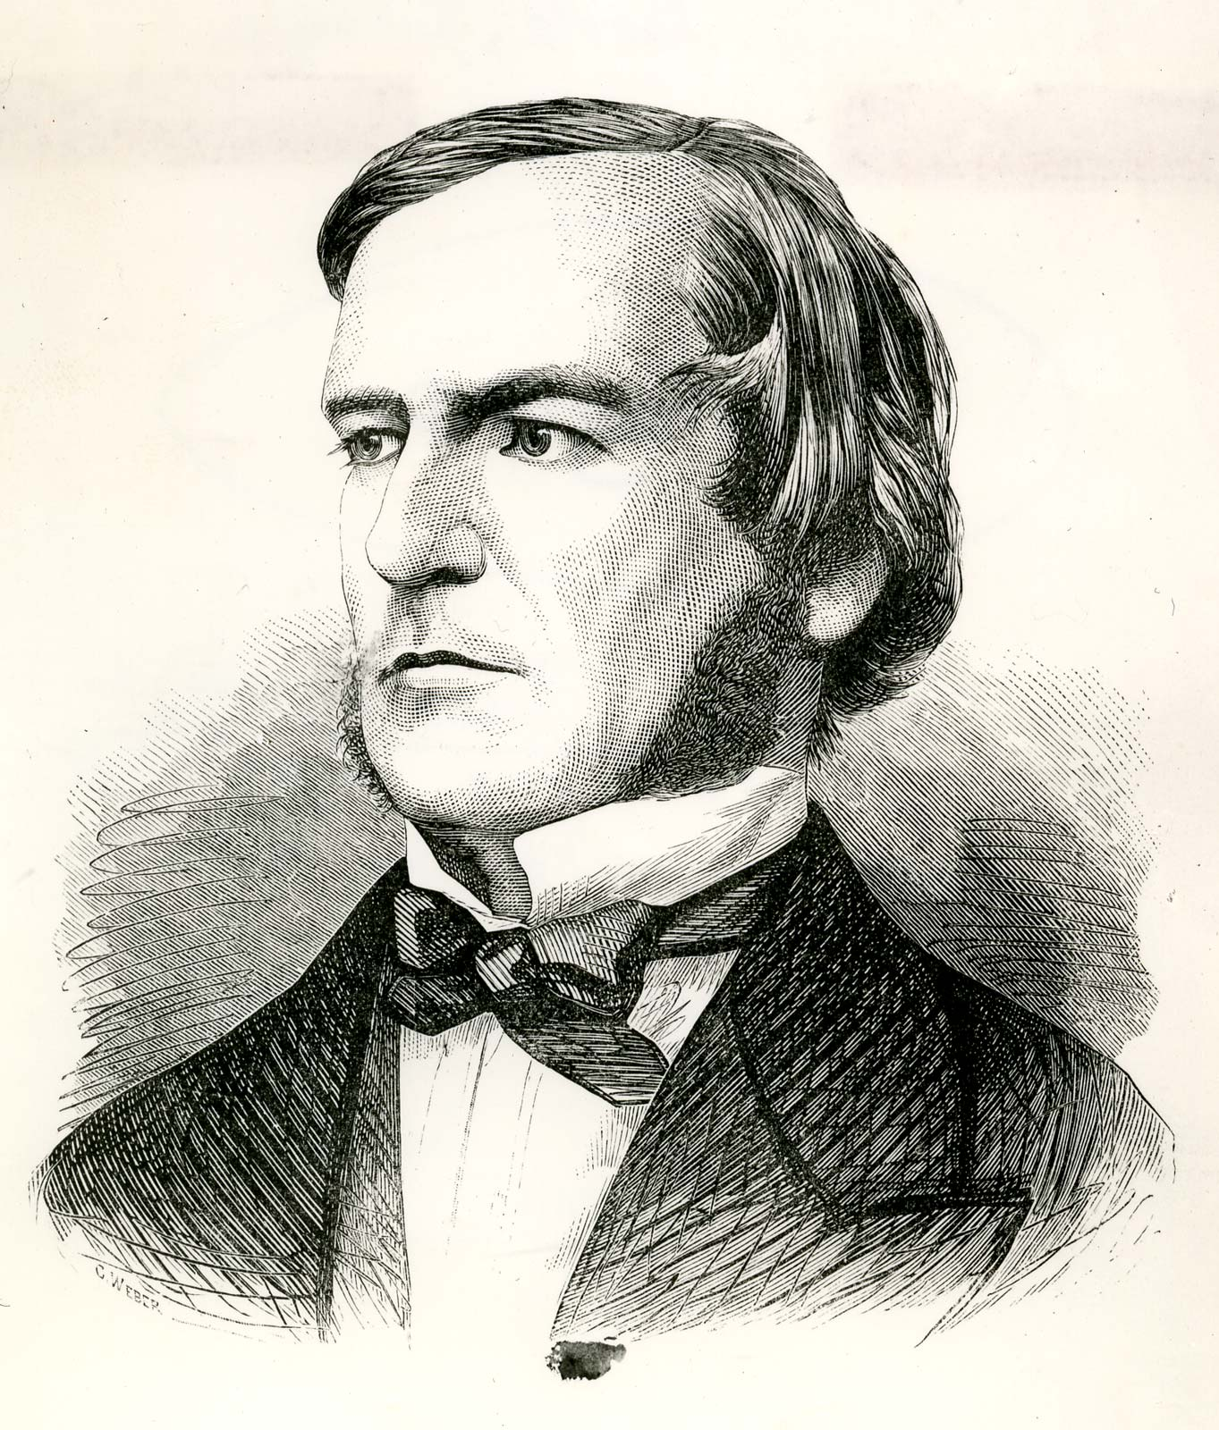

Slide 22
Career & jobs:
Directly related to Mathematics:
Mathematics would be useful:
Actuarial analyst
Chartered accountant
Data analyst
Investment analyst
Research scientist (maths)
Secondary school teacher
Statistician
Systems developer
Civil Service fast streamer
Financial manager
Financial trader
Insurance underwriter
Meteorologist
Operational researcher
Quantity surveyor
Software tester

Slide 23
KARİYER & MESLEKLER:
Doğrudan Matematik ile İlgili Meslekler:
Matematiğin faydalı olduğu alanlar:
Aktüerya
Hesap Uzmanlığı
Veri analistliği
Yatırım danışmanlığı
Araştırmacı Bilim insanı
Lise Öğretmenliği
İstatistikçi
Sistem geliştirici
Şehir Bölge Planlaması
Finans yönetimi
Finansal Analiz
Sigortacılık
Meteoroloji
Operasyon uzmanlığı
Risk analizi
Yazılım

Slide 25
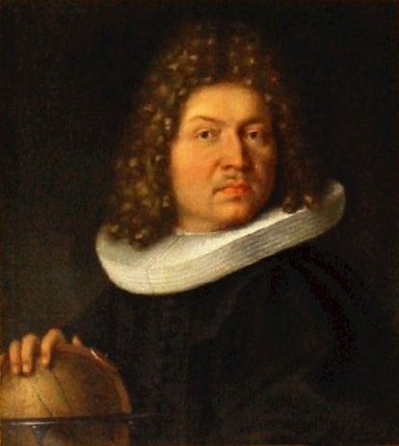
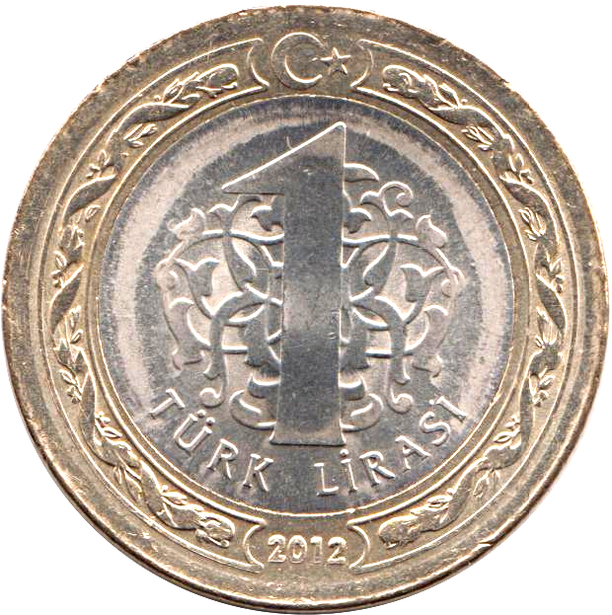
Compound Interest / Bileşik faiz
1 year
$$2$$
6 months
6 months
$$1.5$$
$$2.25$$
$$1∗{\left(1+\frac{1}{12}\right)}^{12}$$
12 months
$$1∗\left(1+\frac{1}{12}\right)$$
n times
$$1∗{\left(1+\frac{1}{n}\right)}^{n}$$
Jacob Bernoulli
$$n=∞$$
$$?$$

Slide 26
$$1∗{\left(1+\frac{1}{n}\right)}^{n}$$
$$n=∞$$
$2.7182818284….=e$
$$e^{iπ}+1=0$$
Leonhard Euler

Slide 28
Currıculum / Müfredat
FIRST YEAR
First Semester
Course Code | Course Name
ENG 1003 | Communications Skills and Academic Reporting I
HIST 1001 | Atatürk's Principles and History of Turkish Republic I
MAT 1001 | Analysis I
MAT 2033 | Discrete Mathematics
PHY 1001 | Physics I
Second Semester
Course Code | Course Name
ENG 1003 | Communications Skills and Academic Reporting I
HIST 1002 | Atatürk's Principles and History of Turkish Republic II
MAT 1002 | Analysis II
MAT 1004 | Abstract Mathematics II
PHY 1002 | Physics II

Slide 29
Currıculum / Müfredat
SECOND YEAR
First Semester
Course Code | Course Name
MAT 2001 | Analysis III
MAT 2003 | Linear Algebra I
SEN 1001 | Introduction to Programming (Java)
TLL 1003 | Discrete Mathematics
 | Elective
Second Semester
Course Code | Course Name
MAT 2002 | Analysis IV
MAT 2004 | Linear Algebra and Analytic Geometry
MAT 2006 | General Topology
MAT 2062 | Differential Equations
SEN 1002 | Object Oriented Programming (Java)
TLL 1004 | Turkish Language and Literature II

Slide 30
Currıculum / Müfredat
THIRD YEAR
First Semester
Course Code | Course Name
MAT 3001 | Real Analysis I
MAT 3003 | Algebra I
MAT 3005 | Differential Geometry I
 | Departmental Elective
 | General Elective
 | General Elective
Second Semester
Course Code | Course Name
MAT 3004 | Algebra II
MAT 3006 | Differential Geometry II
MAT 3008 | Complex Analysis
MAT 3026 | Probability and Statistics
 | General Elective
 | General Elective

Slide 31
Currıculum / Müfredat
FOURTH YEAR
First Semester
Course Code | Course Name
MAT 4011 | Seminar I
 | Departmental Elective
 | Departmental Elective
 | Non-Departmental Elective
 | General Elective
Second Semester
Course Code | Course Name
MAT 3010 | Number Theory
MAT 4012 | Seminar II
 | Departmental Elective
 | Departmental Elective
 | Non-Departmental Elective

